Slide 1
vfb-p-flybase2kb
vfb-kb
Pull flybase stuff and add to KB
vfb-kb2
vfb-p-flybase2kb
vfb-p-kb2kb
vfb-p-kb-enrich
yyz1989/rdf4j
vfb-pipeline-collectdata
vfb-pipeline-updatetriplestore
vfb-integration-api
vfb-solr
vfb-prod
owlery-vfb
vfb-p-prod
vfb-p-owlery
vfb-p-solr
vfb-p-kb2kb
vfb-solr
Usual kb-image
Incl Neo2OWL plugin
Transform to new schema
vfb-p-kbenrich
vfb-p-solr
Overlaps rels
Et al.
Obtains rdf
Config solr core
vfb-integration-api
REST
vfb-prod2
vfb-p-prod
vfb-pipeline-collectdata
Creates custom RDF dumps for each service
Obtains rdf
Prepro
Neo4j load
Pulls raw data from various sources
Dumps RDF, zip
vfb-p-owlery
vol
yyz1989/rdf4j (triplestore)
Might be redundant
Configures vfb-owlery
vfb-pipeline-updatetriplestore
vfb-owlery
Load RDF dumps into triplestore
Fires up triple store from scratch

Slide 2
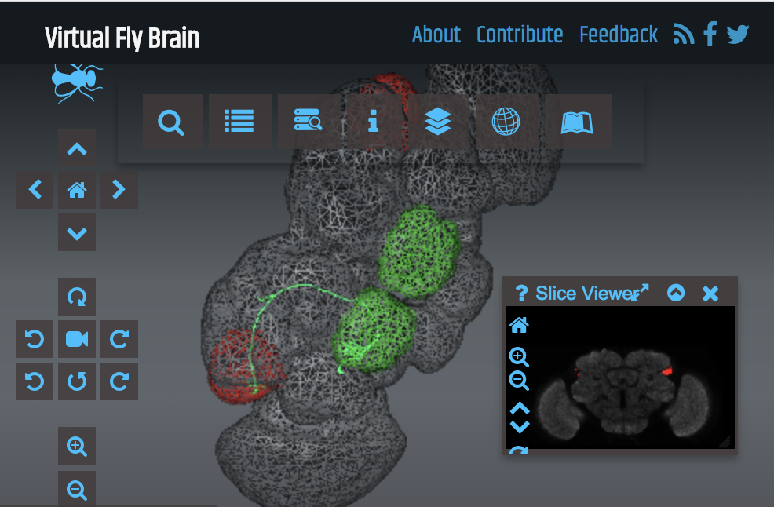
Pipeline - aims
Neo4j prod:
Graphs;
Basic metadata
FlyBase
Geppetto
CATMAID
(connectomics)
Integration layer
= triple store
SOLR:
Autocomplete search
URI
sync
annotation
ontologies
OWL:
Queries
VFB annotation
(KB)
URI
sync
New entities
NBLAST
Same? Nico says definitely not.
Image files

Slide 3
NBLAST
URI sync
URI sync
TSV
KB
Production Deploy
dipper
e.G Materialisation, Most specific classification

Slide 4
VFB Curator
URI sync
URI sync
…
Flybase
KB
Ingest, Validation
REST API
dipper
Triplestore Post-processing,
e.g Materialisation, Most specific classification

Slide 5
Get OWL
Build Index
Pipeline
Dipper run
Set up Triplestore
Ingest subgraphs by datasource
Set up web services
REST
Set up neo
Import procedure
Run procedure
Set up owlery server
Import OWL
Precompute inferences

Slide 6
DATARAW
DATA
Collect all relevant sources in DATARAW
Run dipper
Copy files to DATARAW
Copy VFB.owl and others to DATARAW
Preprocess data in DATARAW
Convert all files to RDF/XML and gzip
Verify form
COPY to DATA
Set up Triple store
Create fresh local triple store
Load all files in DATA and feed into triplestore

Slide 7
KB Schema
FB:pub
Individual
Feature
Object Property
rdf:type
Annotation Property
Template
BiologicalEntity
Feature
Cluster
Class
has_neo_type
rdf:type
any
rdf:type
member_of
OWL relation
AnatomicalEntity
has_member
Channel
hasDbXref
Site
in_register_with
depicts
rdf:type
has_source
Image
Image
in_register_with
DataSet
has_reference
Is_specified_output_of
has_license
License
ImagingMethod

Slide 8
Neo2OWL
Individual I
For all attributes a in I
If annotationPropertyWithSafeLabelExists(a) → annotationAssertion(I.iri,iri(a),I.x)}
Else ignore (i.e. assume it is taken care of by other means or is irrelevant?)
For all labels t in I
If (classWithSafeLabelExists(t) → owlClassAssertion(I,iri(t))
Else annotationAssertion(I,vfb:neoconvenience,iri(t))
Class C
annotationAssertion(C.iri,obo:deprecated,C.isObsolete)
Annotation Property A
annotationAssertion(A.iri, vfb:safeLabel, A.safeLabel)
Object Property P
annotationAssertion(P.iri, vfb:safeLabel, P.safeLabel)
Edge E: (x)-[R]-(y)
If R annotation property: OWLAnnotation(x.iri,R,y.iri)
If x,y individuals:
OWLObjectPropertyAssertion(x,R,y)
If x individual, y class:
ClassAssertion(x,R some y)
If x class, y class
SubClassOf(x,R some y)
If x class, y individual
SubClassOf(x,R value y)
HOW TO DEAL WITH PROVENANCE?

Slide 9
OWL2Neo
For annotations <I,R,v> on Individual I
If isEntity(v) → (i)-[safeForm(R)]-(v)
Else (i:safeForm(R)=v)
For object property assertions <I,R,I2>
(i)-[safeForm(R)]-(v)
For a:R some C
For a:R some {a} / R value a
For C sub R some D
For C sub D
For C sub R some {a} / R value a
Axiom annotations will be done as edge attributes:
shortForm(AP):
Individuals I
Node(iri=I.iri, NamedIndividual, safeForm(OP))
Annotation Properties AP
Node(AP.iri, :AnnotationProperty, safeForm(OP), …)
Object Property OP
Node(OP.iri, :ObjectProperty, safeForm(OP), …)
Class C
Node(C.iri,:Class, safeForm(Class),…)

Slide 10
Create Individual Nodes
Create Class Nodes
Create ObjectProperty Nodes
Create AnnotationProperty Nodes
Create entity annotations
To other entities
To literals
Create relationships
OPAssertions
I -> I
Existential restrictions
I -> C
C -> I
C -> C

Slide 11
Semantics of Template?
We need an extra rule for class labels that have no refered classes

Slide 12
VFB KB
Stores:
Annotated images:
Entities depicted = Typed OWL individuals
Image individuals have basic typing + link to templates registered to. Registration edge contains file links & some reg specific metadata
Images may be from light microscopy, EM reconstruction, annotated schematics
Does not store
Connectomic data
General assertions about expression/phenotype
Axioms from imported ontologies apart from annotation axioms for label, iri, short_form – recorded as node attributes.

